Slide 1
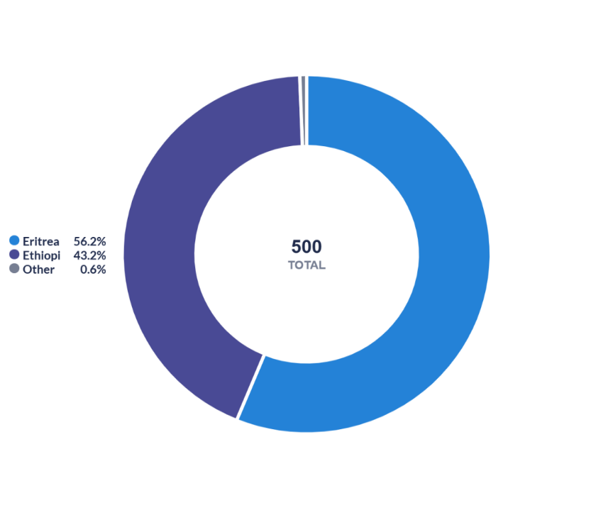
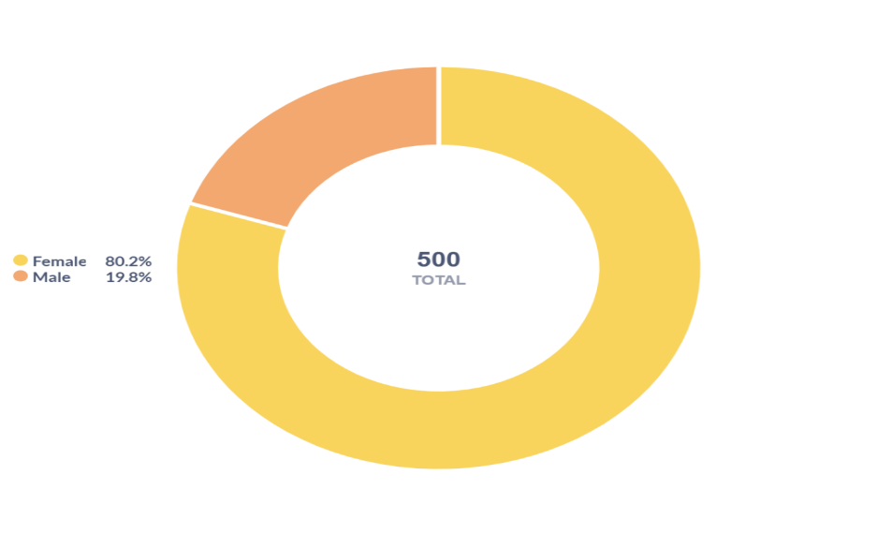
Gender distribution
Distribution by Nationality
216 (43.2%
99 (19.8%)
281(56.2.%)
401(80.2)

Slide 2
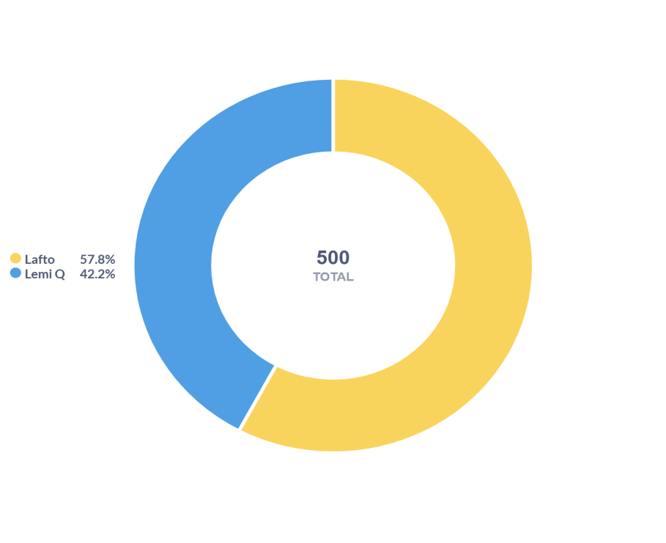
Distribution across sub-cities
289(57.8%)
211(42.2%)

Slide 3
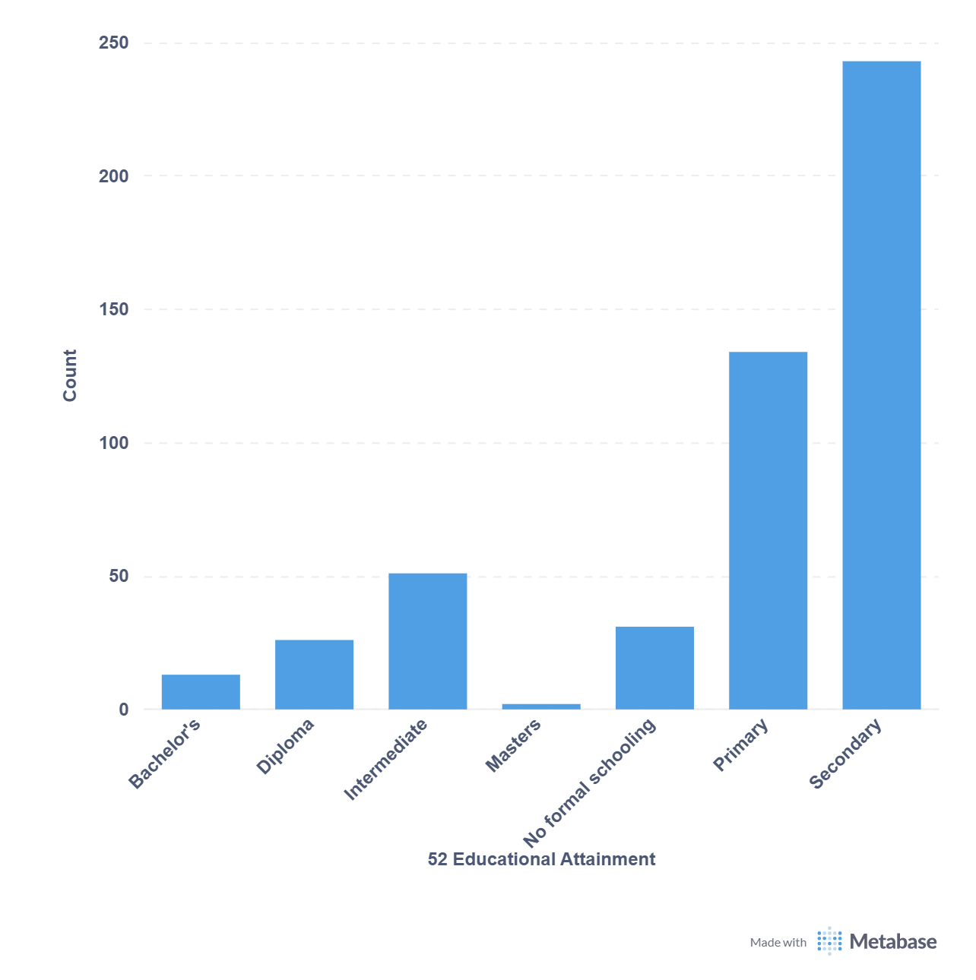
Educational Attainment
243
134
51
26
31
13
2

Slide 4
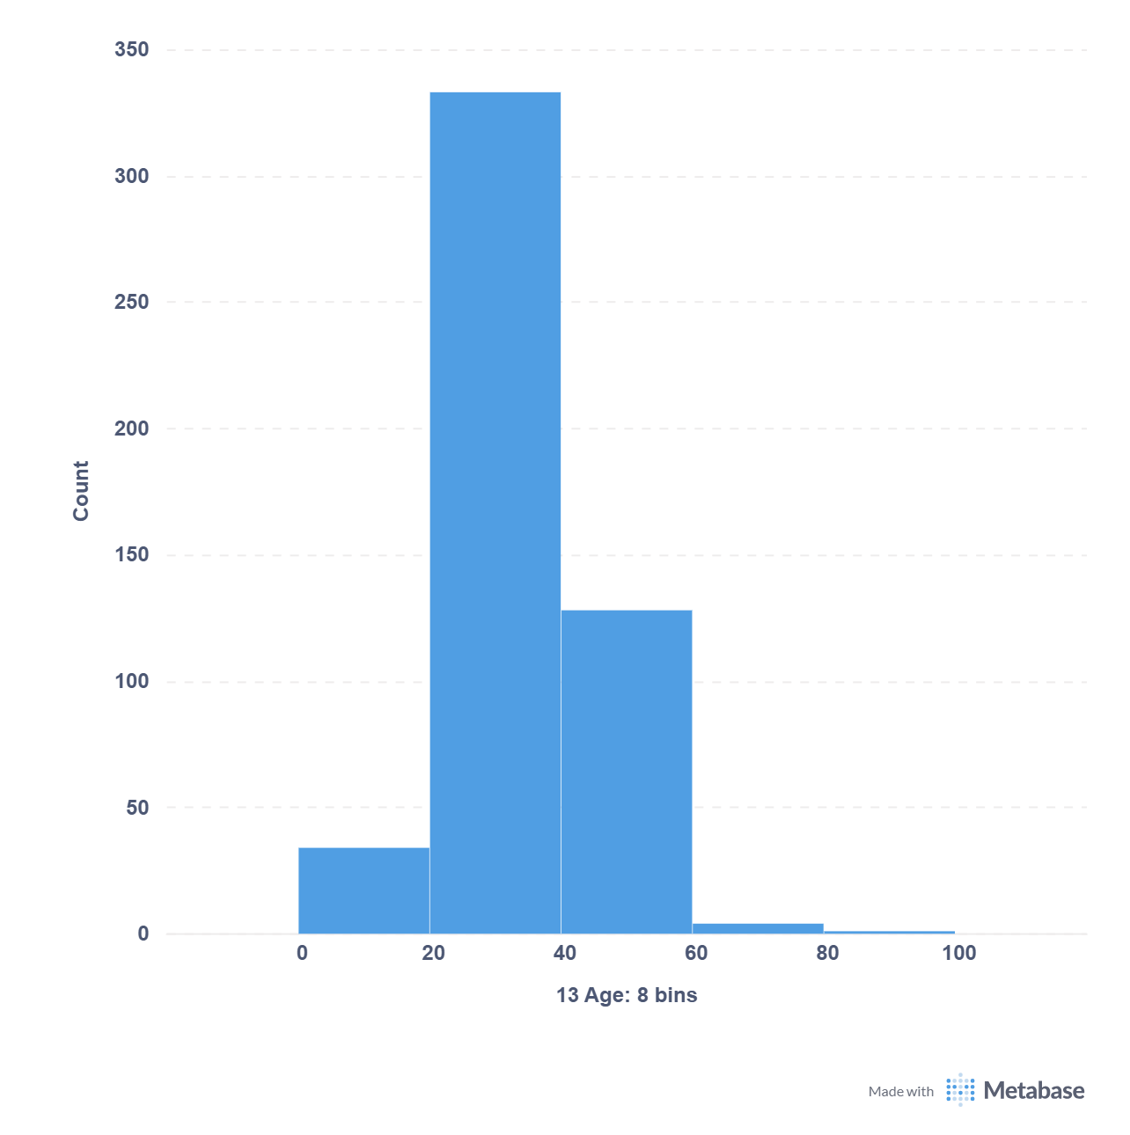
Age Category
333
128
34
4
1

